Slide 1


Digitizing Arabic Handwrite
Instructor:
Mohammed Almubaddil
Alaa bin Othman
Abdulaziz Aldughaythir
Class: 14

Slide 2
Problem
Unreadable handwriting.
Old documents with fading ink.

Slide 3
Our Suggested Solution
Handwriting Recognition Systems:
Develop deep learning-based handwriting recognition systems that can automatically transcribe handwritten text into digital form. This technology can be integrated into educational tools to assist both students and teachers.

Slide 4
Methodology
Phase 1:
Preprocessing.
Phase 2:
Training.
Phase 3:
Compiling.
Phase 4:
Result.

Slide 5
Dataset
We used KHATT dataset that was created by professors from KFUPM.
More than 1000 different writers.
different resolutions (200, 300, and 600 DPIs).
Writers are from different countries, gender, age groups, handedness and education level.
2000 unique paragraph images and their segmented line images (source text from different topics like arts, education, health, nature, technology).

Slide 6
Progress
Phase | Progress
Preprocessing | Done
Training | Done
Compiling | Done
Result | In progress

Slide 7
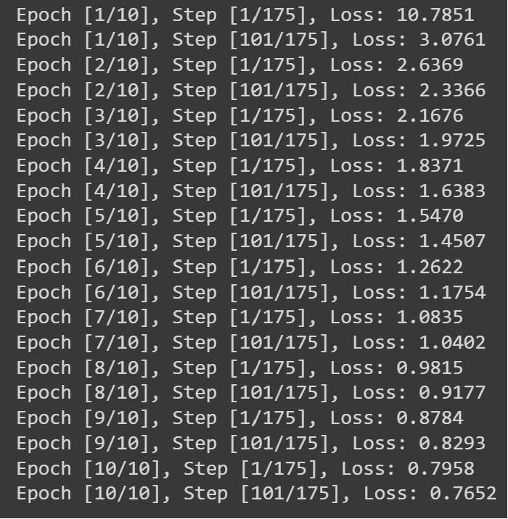
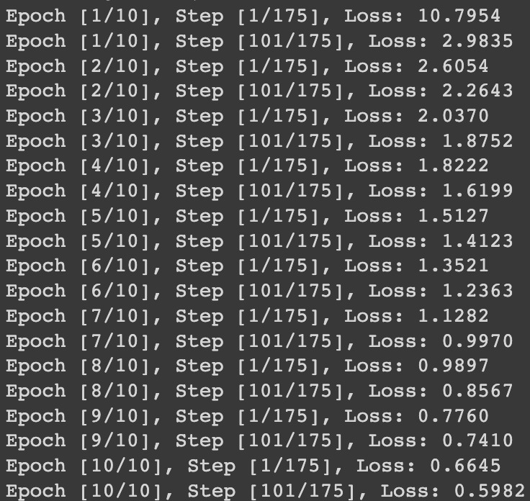
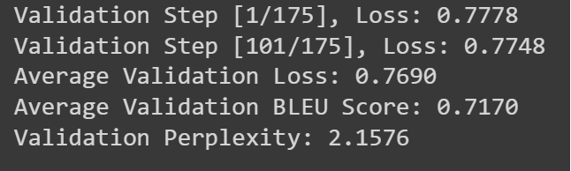
Output

Slide 8



Challenges
Computing power.
Limited time.
Data shortage.
No time to create a dataset.
Variations of Arabic handwriting.

Slide 9
Future Work
Software integrated with scanners.
Retrain the model to detect the faded ink

Slide 10
Thank you.

